Slide 1

Effects of Hardness and Cosurfactant on Phase Behavior of Alcohol-Free Alkyl Propoxylated Sulfate Systems
Maura C. Puerto, Clarence A. Miller and George J. Hirasaki
Rice University
Carmen Reznik, Sheila Dubey, Julian R. Barnes and Sjoerd vanKuijk Shell Global Solutions
Presented at Annual Meeting of Rice University Consortium
on Processes in Porous Media, April 21, 2014
Based on SPE 169096-MS presented at SPE Symposium on IOR
Tulsa, OK, April 14-16, 2014

Slide 2
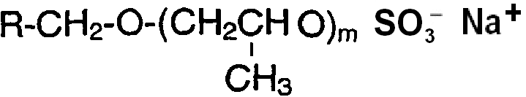
TOPICS 1 of 2
Slide 2
            Behavior of Surfactant Blends
            WOR ~1 with n-octane and its Aqueous Solutions
Alcohol Propoxy Sulfates
APS
Alcohol Ethoxy Sulfates
AES
Internal Olefin Sulfonate
SO₃-Na SO₃-Na
R-CH₂-CH₂- CH –CH -CH₂-CH₂-R’ ⁺ R-CH₂ – CH-CH= CH-CH₂-R’
OH
Hydroxyalkane Sulfonates + Alkene Sulfonates
IOS
SPE 169096 – MS • Maura C Puerto

Slide 3
TOPICS 2 of 2
Slide 3
      Phase Behavior
    Optimal Blends with n-octane, a crude oil
    Injection Composition without oil
    Salinity Maps for variable salinity processes
SPE 169096 – MS • Maura C Puerto

Slide 4
OBJECTIVE
Slide 4
Slide 4
Without adding alcohol, determine effect of hardness on equilibrium phase behavior for three blend types.
Challenge: Low-tension Oil-Water-Surfactant systems are suitable for injection when made as microemulsions but seldom suitable when made as aqueous solutions, which are often cloudy or form precipitates.
Blend | Research Focused on
APS/IOS₁₅₋₁₈ | Finding aqueous single-phase solutions capable of generating low-tension in hard brines such as seawater
APS/APS
APS/AES
SPE 169096 – MS • Maura C Puerto
SPE 169096 – MS • Maura C Puerto

Slide 5
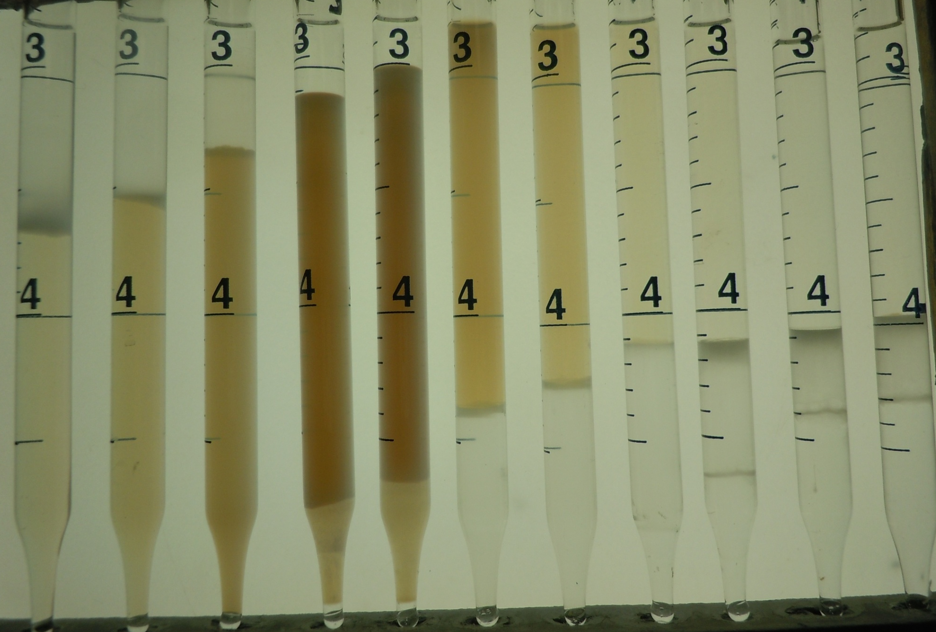
Experimental Highlights
Slide 5
Typical brine composition Oil Test Temperature
n-octane ambient to <60°C
a crude oil
Wt% Salt | SW
NaCl | 2.9 | 4.0
CaCl₂ | 0.13
MgCl₂ 6H₂O | 1.12
TDS (g/L) | 35.5 | 40.0
Ionic strength mol/L | 0.70 | 0.68
Salinity Scan: SW/15%NaCl mixtures, WOR~1
2%total b-C₆₇7P/IOS_1/1 by wt, n-C₈, ~25°C
SW 9/1 8/2 7/3 6/4 5/5 6/4 7/3 8/2 9/1 15%NaCl
0 1 2 3 4 5 6 7 8 9 10
~9weeks of equilibration
SPE 169096 – MS • Maura C Puerto

Slide 6
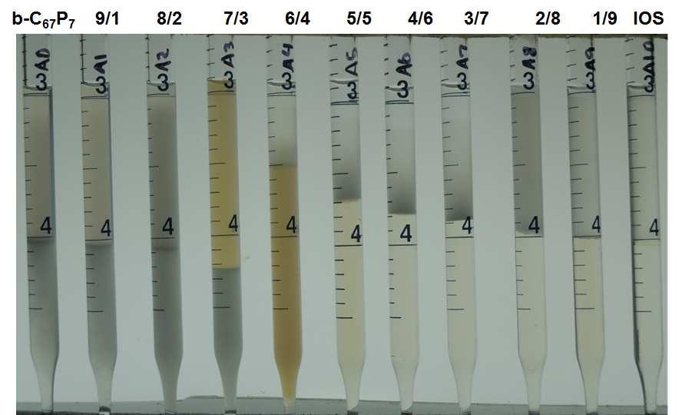
Surfactants Used in Blend Scans
Slide 6
Hydrophobe | Propoxy Groups |  |  |  | Ethoxy Groups | Named
Sulfates
Branched C₁₆₋₁₇ |  | 7 |  | 0 |  | b-C₆₇ 7P
Lower branched C₁₂₋₁₃ |  | 7 |  | 0 |  | b-C₂₃ 7P
Higher branched C₁₂₋₁₃ |  | 7 |  | 0 |  | B-C₂₃ 7P
Lower branched C₁₂₋₁₃ |  | 0 |  | 7 |  | b-C₂₃ 7E
Higher branched C₁₂₋₁₃ |  | 0 |  | 7 |  | B-C₂₃ 7E
Sulfonate
Internal Olefin Sulfonate 15-18 |  |  |  |  |  | IOS
Blend Scan
b-C₆₇ 7P/IOS
2wt% total
2*SW, 25°C,
WOR~1, n-C₈
Bø = Optimal Blend
SPE 169096 – MS • Maura C Puerto

Slide 7
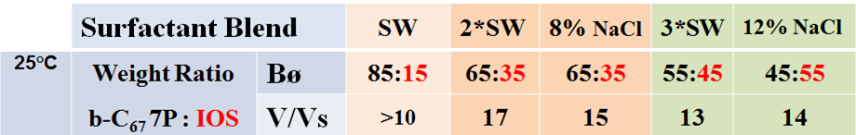
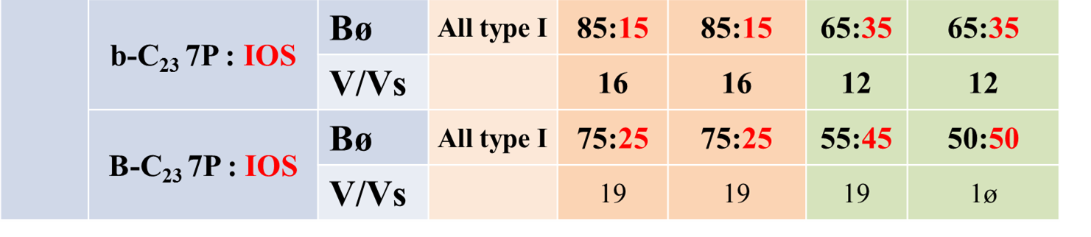
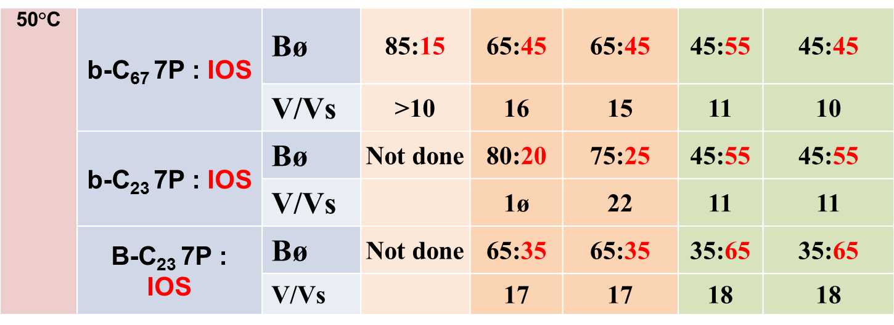
Optimal Blend Ratios : APS/IOS
Hard and Soft brines of Equal Ionic Strength
=
=
High oil & brine solubilization parameters near optimal conditions so, highly promising for EOR processes
2*, 3*SW reveal tolerance to both salinity & hardness
Unclear Aqueous Solutions 2*, 3*SW or 8 ,12% NaCl

Slide 8
Optimal Blend Ratios : APS/IOS
Slide 8
=
=
50°C | b-C₆₇ 7P : IOS | Bø | Not done | 45:55 | 45:55 | 25:75 | 35:65
 |  | V/Vs |  | 16 | 15 | 11 | 10
 | b-C₂₃ 7P : IOS | Bø | Not done | 80:20 | 75:25 | 45:55 | 45:55
 |  | V/Vs |  | 1ø | 22 | 11 | 11
 | B-C₂₃ 7P : IOS | Bø | Not done | 65:35 | 65:35 | 35:65 | 35:65
 |  | V/Vs |  | 17 | 17 | 18 | 18
SPE 169096 – MS • Maura C Puerto

Slide 9
Aqueous Solubility Map for SW: APS/IOS at 25ºC
Slide 9
Generally difficult to find clear aqueous solution at optimal
Precipitation of IOS above ~30% is limitation here
SPE 169096 – MS • Maura C Puerto

Slide 10
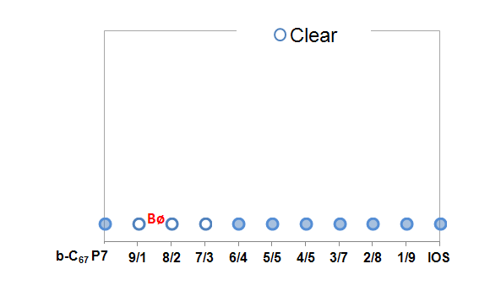
Salinity Map for Variable Salinity: APS/IOS at 25°C
Slide 10
Possible Aqueous Injection blend range:
65/35 - 85/15
of b-C₆₇ 7P/IOS
Too much IOS , too high IFT
Too much APS, transition to Winsor Type II :
surfactant will be lost by partitioning into oil, making heavy emulsion, etc.
WINSOR TYPE I
Dilution path
WINSOR TYPE II
SPE 169096 – MS • Maura C Puerto

Slide 11
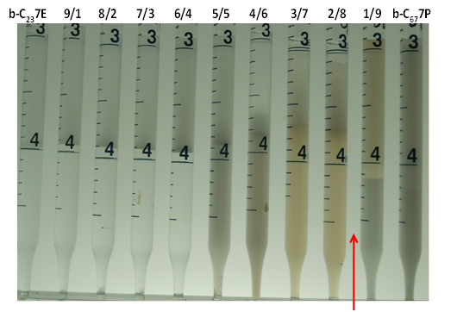
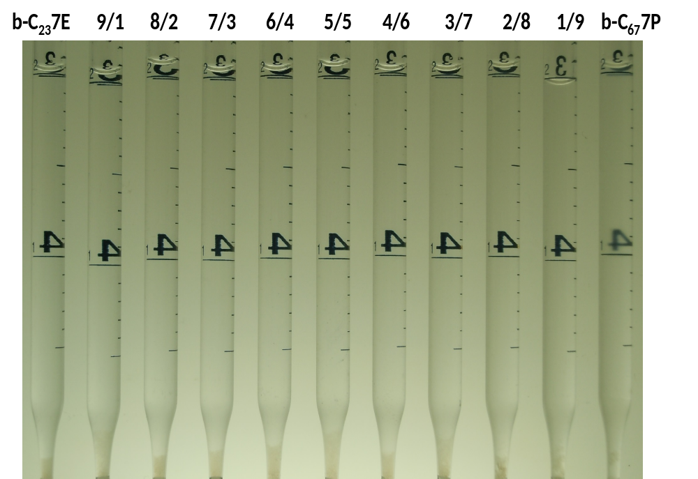
Blends of APS/APS and APS/AES at 25⁰C
Slide 11
Example : b-C₂₃ 7E and b-C₆₇ 7P
2% Surfactant
WOR ~ 1
SeaWater
n-Octane
1% Surfactant
in SW, Aqueous
Solutions
Cloudy
Clear
SPE 169096 – MS • Maura C Puerto

Slide 12

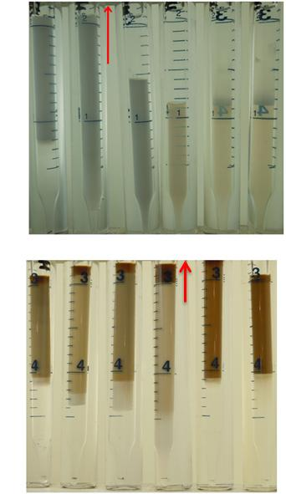
Model Oil n-octane and Crude oil at ~50ºC
Optimal AES/APS ratio as a function of Oil Molar Volume
Slide 12
Phase Behavior b-C₂₃7P/B-C₁₃7E:
90 88 86 84 82 80
The small difference indicates that n-octane is a good choice of model oil to be used for initial screening purposes in this system.
SPE 169096 – MS • Maura C Puerto

Slide 13
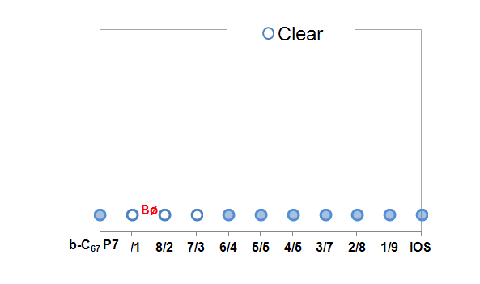
Aqueous Solubility Map for SW: 1%APS/APS 25ºC
Slide 13
Ethoxy or Propoxy groups on both surfactants provide tolerance to salinity and hardness, that is greater than when one surfactant is IOS
_{ø}
SPE 169096 – MS • Maura C Puerto

Slide 14
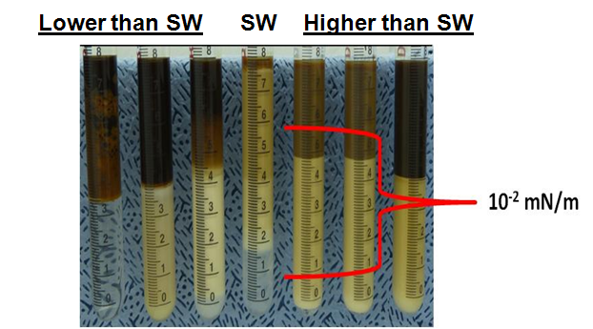
APS/AES blend produced Low IFT against crude oil,
as expected from its phase behavior with n-octane
Slide 14
Phases selected for IFT measurements from phase behavior salinity scan with crude oil:
1% b-C₂₃ 7P and B-C₂₃7E
SW at ~50°C.
Shows Winsor III behavior.
IFT measured between excess oil and brine phases = ~10⁻² mN/m.
Based on discussion by Sottmann and Strey (1997), IFT values of microemulsion/oil and microemulsion/brine interfaces < 10⁻² mN/m
Substantial residual oil should be displaced for these conditions.
SPE 169096 – MS • Maura C Puerto

Slide 15
Conclusions 1of 3
Slide 15
Blends of branched APSs with IOS₁₅₋₁₈
Form alcohol-free microemulsions with n-octane having high oil solubilization at optimal conditions up to 3*SW and 50ºC.
Have similar optimal blend ratios for same ionic strength of 2*SW, 3*SW and NaCl solutions at 25ºC, 50ºC.
  oil-free aqueous solutions unsuitable for injection (cloudy and/or precipitate) for same conditions.
In SW aqueous solutions unsuitable for injection beyond ~30% IOS at 25ºC.
SPE 169096 – MS • Maura C Puerto

Slide 16
Conclusions 2 of 3
Slide 16
Blends of branched APSs with other APSs or AESs
Appear more favorable than APS/IOS for having aqueous solutions suitable for injection over a range of optimal blend ratios, at least at low temperatures in SW.
2. Formed alcohol-free microemulsions promising for EOR with a crude oil in SW at ~50ºC with two APS/AES blends
3. Had cloudy aqueous solutions at opt. blend ratios with crude oil at 50C but clear at slightly different ratios exhibiting lower phase microemulsions.
SPE 169096 – MS • Maura C Puerto

Slide 17
Conclusions 3 of 3
Slide 17
    Salinity maps as shown here for n-octane but not shown for crude oil should prove useful in designing IOR processes where compositions of injection and formation brines differ.
SPE 169096 – MS • Maura C Puerto

Slide 18
Slide 18
Thank You
Questions?
Grateful to Shell Global Solutions for funding this research

Slide 19
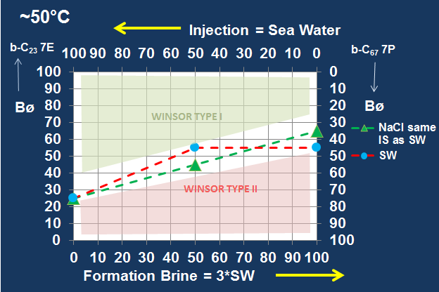
Salinity Map for a Crude oil: AES/APS at ~50°C
Slide 19
SeaWater and
NaCl-only brine
of same Ionic Strength
SPE 169096 – MS • Maura C Puerto

Slide 20
Salinity Map for SW and Crude oil: 1% b-C₂₃7P/ b-C₆₇7P
Slide 20
~50ºC
all Clear at 25ºC
Bø
SPE 169096 – MS • Maura C Puerto

